Slide 1
Accurate Vehicle Localization: A Survey
ZHU Zhuangdi
Supervised by WANG Yi
Notes:
Inertia navigation system, https://en.wikipedia.org/wiki/Inertial_navigation_system

Slide 2
Outline
Motivation
Main Solutions
Examples
Future Trends

Slide 3
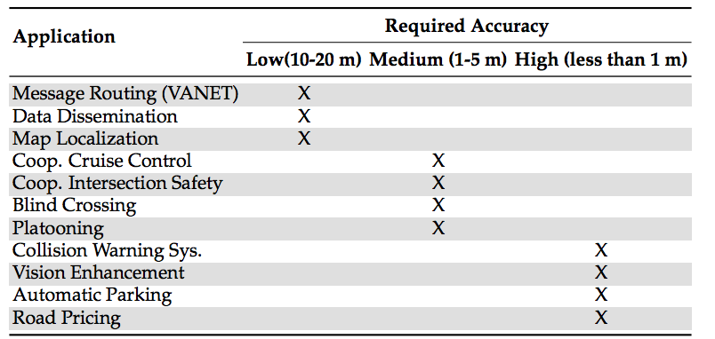
Motivation
Application requirements vary

Slide 4
Motivation
Inaccurate GPS-only localization
Source of User Equivalent Error Range^{[1]}:
Source | Effect(m)
Signal arrival(C/A) | ±3
Signal arrival P(Y) | ±0.3
Lonospheric effects | ±5
Ephemeris errors | ±2.5
Satellite clock errors | ±2
Multipath distortion | ±1
Tropospheric effects | ±0.5
3σR C/A | ±6.7
3σR P(Y) | ±6.0
Error Analysis of GPS, https://en.wikipedia.org/wiki/Error_analysis_for_the_Global_Positioning_System

Slide 5
Main Solutions
Absolute Localization
Single Vehicle Scenario
Relative Localization
Collaborative Vehicle Localization
State Estimation
INS
Particle Filtering
Kalman Filtering
Data Fusion
Multiple Sensors
Map/Satellite/Camera/Video based
Fault Correction
Multipath Detection
Differential GPS
GPS

Slide 6
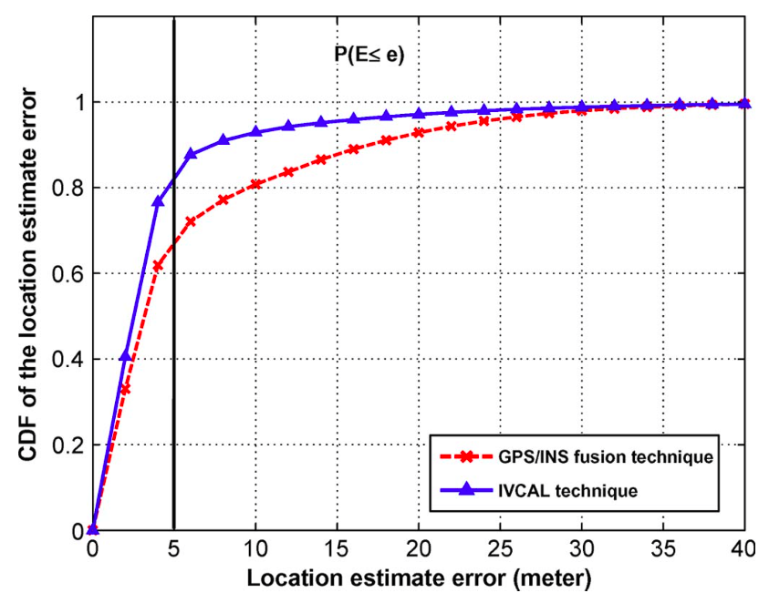
Example.1
Intervehicle-Communication-Assisted Localization^{[1]}
Main Idea:
GPS + INS + Kalman Filtering + Multipath Detection + Relative Localization
Drawil N M, Basir O. Intervehicle-communication-assisted localization[J]. Intelligent Transportation Systems, IEEE Transactions on, 2010, 11(3): 678-691.
Notes:
Drawil N M, Basir O. Intervehicle-communication-assisted localization[J]. Intelligent Transportation Systems, IEEE Transactions on, 2010, 11(3): 678-691.

Slide 7
Example.1
Intervehicle-Communication-Assisted Localization(IVCAL)^{[1]}
System Architecture:
Localization Enhancement Unit
IVCAL Estimate
IMU measurement
GPS-INS Fusion Unit
Multipath Detection Unit(MDU)
GPS Reading
Drawil N M, Basir O. Intervehicle-communication-assisted localization[J]. Intelligent Transportation Systems, IEEE Transactions on, 2010, 11(3): 678-691.
Notes:
Drawil N M, Basir O. Intervehicle-communication-assisted localization[J]. Intelligent Transportation Systems, IEEE Transactions on, 2010, 11(3): 678-691.

Slide 8
Example.1
Intervehicle-Communication-Assisted Localization^{[1]}
Steps:
GPS-INS Fusion
Kalman Filtering
Multipath Detection Unit(MDU)
Feed Forward Back-propagation Network
Localization Enhancement Unit
Least Square Formulation(Relative Localization)
Drawil N M, Basir O. Intervehicle-communication-assisted localization[J]. Intelligent Transportation Systems, IEEE Transactions on, 2010, 11(3): 678-691.
Notes:
Drawil N M, Basir O. Intervehicle-communication-assisted localization[J]. Intelligent Transportation Systems, IEEE Transactions on, 2010, 11(3): 678-691.

Slide 9
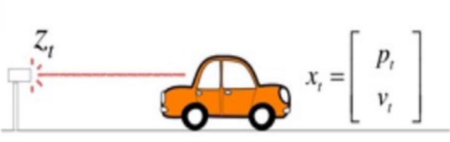
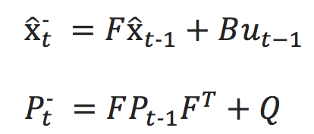
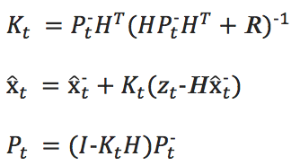
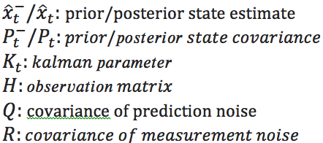
Example. 1
Step 1: GPS-INS Fusion
Prediction
Kalman Filtering：Prediction & Update
Update/Filter:

Slide 10
Example. 1
Neuron
Step 2: Multipath Detection
Information Flow
Input Pattern(Discrepancy between measurement & estimate )
Input Layer
Hidden Layer
……..
Output Layer
Multipath Effect :Yes/No

Slide 11
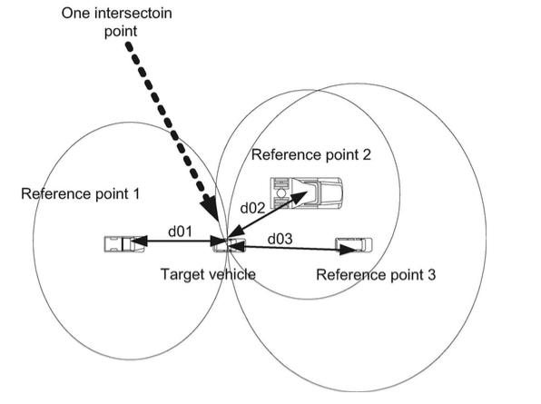
Example. 1
Step 3: Localization Enhancement/Update

Slide 12
Example. 1
Step 3: Localization Enhancement/Update
In paper:
Maybe:

Slide 13
Example. 1
Conclusion
No. | Contributions | Drawbacks
1 | Inter-vehicle location correction | Inaccurate Anchor Locations & Relative Distance -> accumulated error
2 | ANN based Fault Detection | Insufficient Anchor Nodes( < 3 scenario)

Slide 14
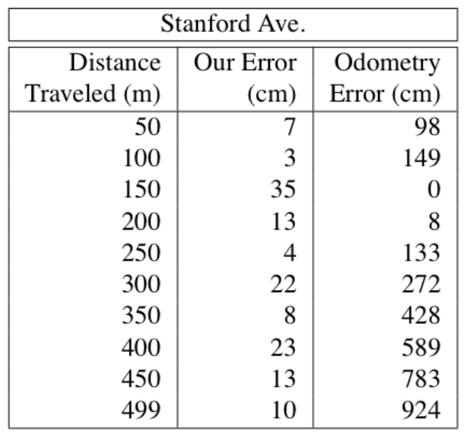
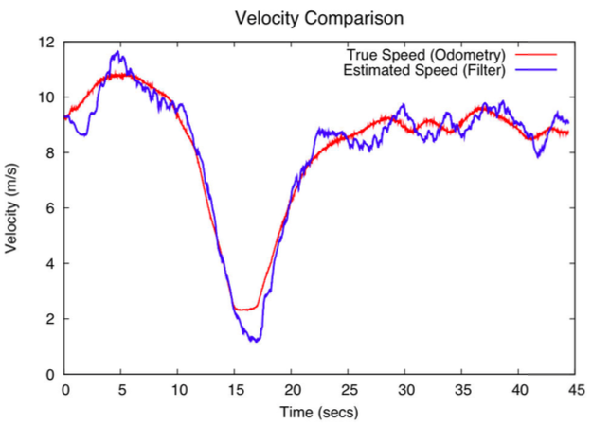
Example. 2
Map-Based Precision Vehicle Localization in Urban Environments^{[1]}
Main Idea:
GPS + Map Matching + INS + Particle Filtering
1. Levinson J, Montemerlo M, Thrun S. Map-Based Precision Vehicle Localization in Urban Environments[C]//Robotics: Science and Systems. 2007, 4: 1.
Notes:
1. Levinson J, Montemerlo M, Thrun S. Map-Based Precision Vehicle Localization in Urban Environments[C]//Robotics: Science and Systems. 2007, 4: 1.

Slide 15
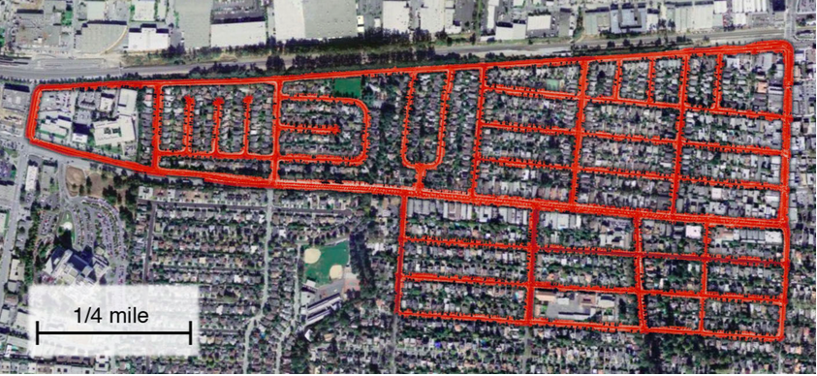
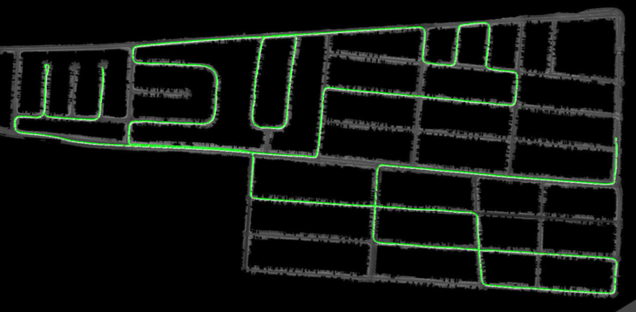
Example. 2
Steps
Mapping & Localization
Fig.1. Mapping
Fig. 2. Localization

Slide 16
Example.2
Steps
Mapping
Using LIDAR to
build 2-D maps
Localization
Real time GPS
localizing relative to
previously created maps
Using particle filtering to
predict and update
vehicle locations
Steps
Mapping
Localization
Techniques
LIDAR Mapping
GPS
INS
Particle Filtering

Slide 17
Example. 2
Mapping
Mapping Technique:
GraphSLAM^{[1]} + LIDAR
Map representation:
2-D surface image
5cm pixel resolution.
Map matching:
Identify regions of overlap
Mapping
Localization
SLAM, wikipedia, https://en.wikipedia.org/wiki/Simultaneous_localization_and_mapping
Notes:
which assigns to each x-y location in the environment an infrared reflectivity value
Visualization of the scanning process: the LIDAR scanner acquires range data and infrared ground reflectivity. The resulting maps therefore are 3-D infrared images of the ground reflectivity. Notice that lane markings have much higher reflectivity than pavement.

Slide 18
Example. 2
Localization
IMU^{[1]} + GPS + Particle Filtering^{[2]}
Mapping
Prior Estimated Value X’_{k}
Posterior Estimated Value X_{k}
Last State Estimated Value X_{k-1}
GPS Measurement
Motion Model
Localization
Weighted Resampling
IMU Parameters
Particle Filtering
Prediction
Filtering/Updating
Iteration
1. Bayesian Filtering: From Kalman Filters to Particle Filters, and Beyond (2003) by Zhe Chen
2. Inertial Measurement Unit, wikipedia, https://en.wikipedia.org/wiki/Inertial_measurement_unit
Notes:
which assigns to each x-y location in the environment an infrared reflectivity value
Visualization of the scanning process: the LIDAR scanner acquires range data and infrared ground reflectivity. The resulting maps therefore are 3-D infrared images of the ground reflectivity. Notice that lane markings have much higher reflectivity than pavement.

Slide 19
Example. 2
Conclusion
No. | Contributions | Drawbacks
1 | High resolution map | Offline map resolution relaxation
2 | Centimeter Accuracy | Map store & management overhead
3 | Able to process particle filter without GPS | Hardware costs
4 |  | Time delay on mapping and localization (a few seconds)

Slide 20
Future Trends
GPS/INS + Location Estimate
Particle Filtering…
Inter-vehicle assisted Localization for Location update and error correction
TOA, AOA, RSSI
Trilateration…
Fault detection using neural networks
FFBN in multipath detection…

Slide 21
Thank You

Slide 22
References
iOnRoad, an android vehicle safety APP, http://v.youku.com/v_show/id_XMzEzODI1MzIw.html
Boukerche A, Oliveira H A B F, Nakamura E F, et al. Vehicular ad hoc networks: A new challenge for localization-based systems[J]. Computer communications, 2008, 31(12): 2838-2849.
Schreiber M, Knoppel C, Franke U. Laneloc: Lane marking based localization using highly accurate maps[C]//Intelligent Vehicles Symposium (IV), 2013 IEEE. IEEE, 2013: 449-454
Najjar E, El Badaoui M, Bonnifait P. Road selection using multicriteria fusion for the road-matching problem[J]. Intelligent Transportation Systems, IEEE Transactions on, 2007, 8(2): 279-291.
Khattab A, Fahmy Y A, Wahab A A. High accuracy GPS-Free vehicle localization framework via an INS-Assisted single RSU[J]. International Journal of Distributed Sensor Networks, 2015, 2015: 71.
J. Rife, Collaborative vision-integrated pseudorange error removal: team-estimated differential GNSS corrections with no stationary reference receiver, IEEE Transactions on Intelligent Transportation Systems, vol.13, no.1, pp.15-24, March 2012
W. Li and H. Leung, Simultaneous registration and fusion of multiple dissimilar sensors for cooperative driving, IEEE Transactions on Intelligent Transportation Systems, vol.5, no.2, pp. 84- 98, June 2004
M. Woo, J. Choi, H. Han, Carrier phase GPS/millimeter-wave radar for vehicle platooning, IEEE Proc. of the Int. Symp. on Industrial Electronics (ISIE), vol.3, pp.1548-1552 vol.3, 2001.
G. Challita, S. Mousset, F. Nashashibi and A. Bensrhair, An application of V2V communications : cooperation of vehicles for a better car tracking using GPS and vision systems, IEEE Vehicular Networking Conference (VNC), pp.1-6, 28-30 Oct. 2009.
Obst M, Bauer S, Wanielik G. Urban multipath detection and mitigation with dynamic 3D maps for reliable land vehicle localization[C]//Position Location and Navigation Symposium (PLANS), 2012 IEEE/ION. IEEE, 2012: 685-691.

Slide 23
Main Solutions
Absolute Localization
Single Vehicle Scenario
Relative Localization
Collaborative Vehicle Localization
State Estimation
INS
Particle Filtering
Kalman Filtering
Data Fusion
Multiple Sensors
Map/Satellite/Camera/Video based
Fault Correction
Multipath Detection
Differential GPS
GPS

Slide 24
Main Solutions
Differential Global Positioning System(DGPS)
Reference station with accurately-surveyed position
Receivers/Rovers have to be enabled for DGNSS
Rovers should be in vicinity of the reference station.
Set up and calibration cost
The roving receivers must remain stationary at each measurement point for a length of time in order to collect the appropriate amount of data.
Satellite-Based Augmentation System/Wide- Area Augmentation System (WAAS)
WAAS gives actual estimates for the contributions of individual error sources in- stead of lumping them together: WAAS serves larger area than DGPS, and the error may not be correlated.
Inertial Navigation System(INS)
Real Time Kinematic Positioning
RTK algorithms are necessarily carrier-phase based and always provide instantaneous and continuous receiver coordinates
stationary reference node.
consistent locks on at least three satellites
Map-matching
Multipath Detection

